Slide 1

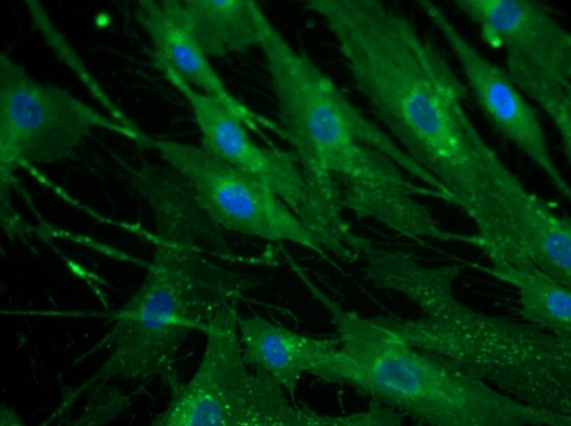
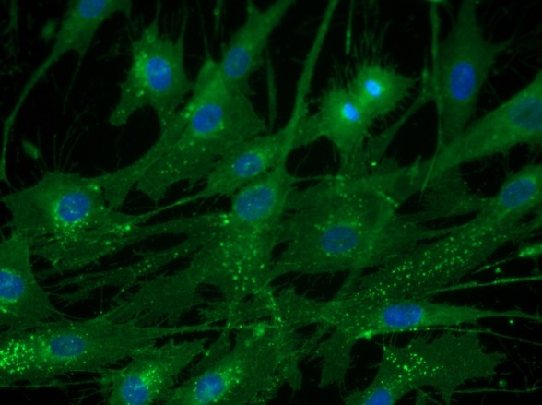
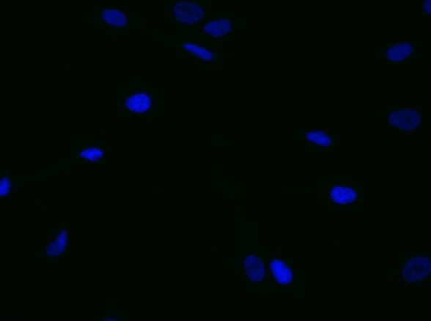
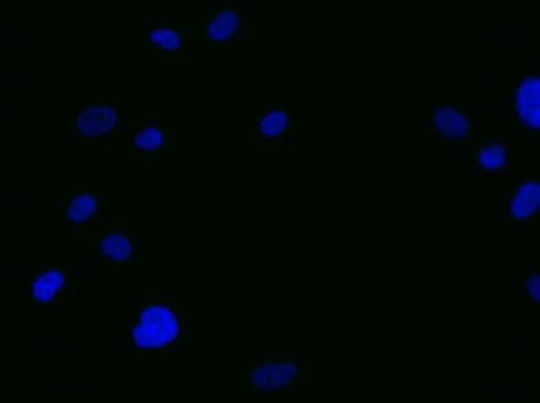
ReliaTech GmbH
Rabbit anti-human Neuropilin-1 (NRP1)
rabbit anti-human NRP-1
rabbit anti-human NRP-1
Control (goat anti-rabbit IgG ALEXA Flour 488; 1:600)
Immunofluorescence staining of NRP-1 in primary human dermal fibroblast cells (HDNF) with polyclonal rabbit anti-human NRP-1 [Cat# 102-PA23AG] (upper panel). Control with goat anti-rabbit ALEXA Flour 488 [Dianova] (lower panel).
[IF_NHDF1406-01; 102-PA23AG (5µg/ml), 400X]
http://www.reliatech.de / info@reliatech.de

